Slide 1
Recommendation System &Spam Review Analysis
Web Scraping Project: Google App Store
Xu Gao

Slide 2
Content
1. Intro detail of web scraping on Google App Store
2. Recommendation System
3. Spam Review Analysis
4. What’s More

Slide 3
Part I: Web Scraping
Source: Google App Store, Top Charts Page, https://play.google.com/store/apps/top
Using Scrapy. Total review: 8972
Top Categoryies:
Top Free in Android Apps
Top Paid in Android Apps
Top Grossing Android Apps
Top Free Games
Top Paid Games
Top Grossing Games
Item Structure:
Each Review
Rating
Category
App
Name
Company
Review
Top Chart
Date

Slide 4
Example:
Review No.1
Rating | Rated 5 stars out of five stars | Category | Action
App | Color Switch | Name | Kalito Doughnuts
Company | Fortafy Games | Review | This is the type of game you can just pickup and play. And…
Top Chart | Top Free in Android Apps | Date | 2/9/2017

Slide 5
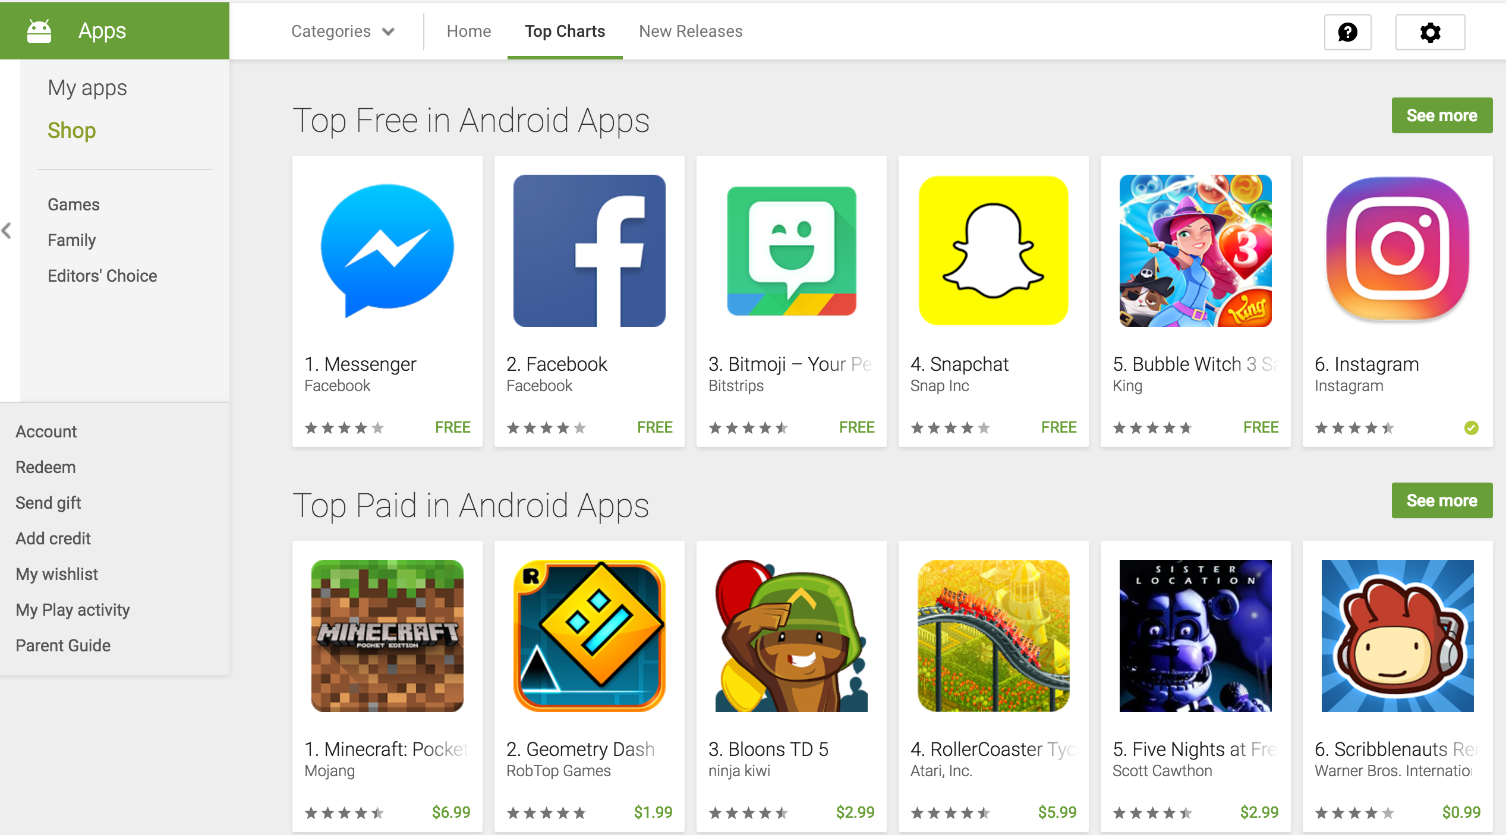
3 Layers of the websites

Slide 6
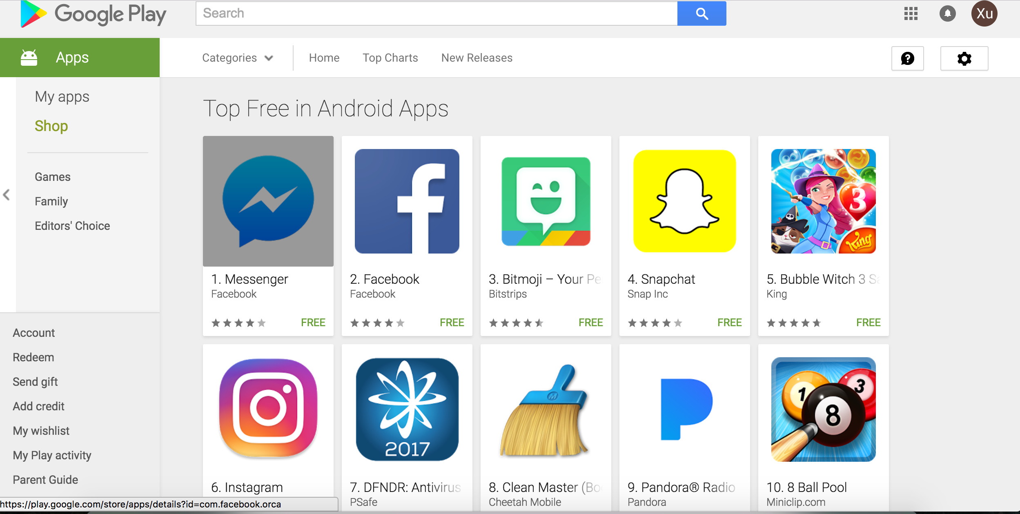

Slide 8
class PttSpider(scrapy.Spider):
Name
Start_URL
def Parse
def Parse_Top
def Parse_Each

Slide 9
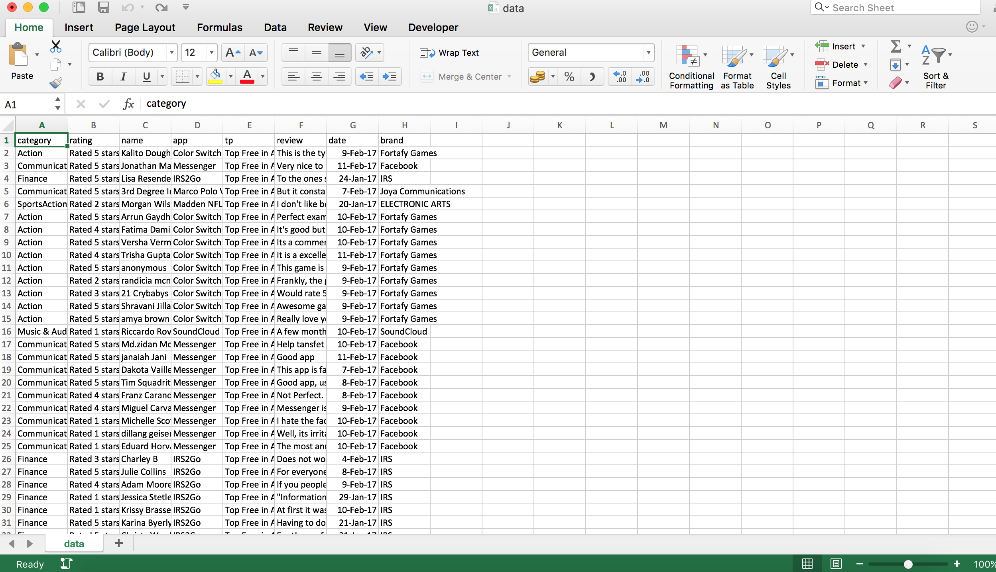

Slide 10
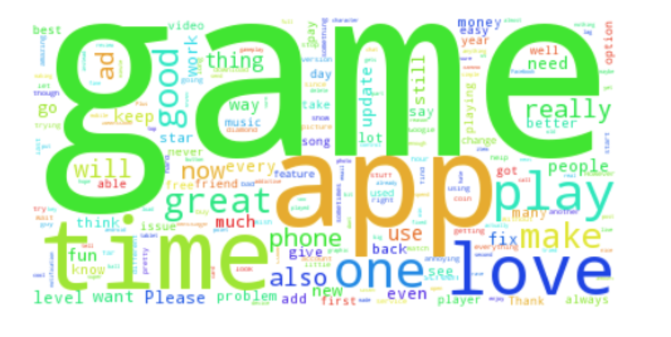
Word Cloud: Top Free in Android Apps, Top Paid in Android Apps, Top Grossing Games
Top Free in Android Apps

Slide 11
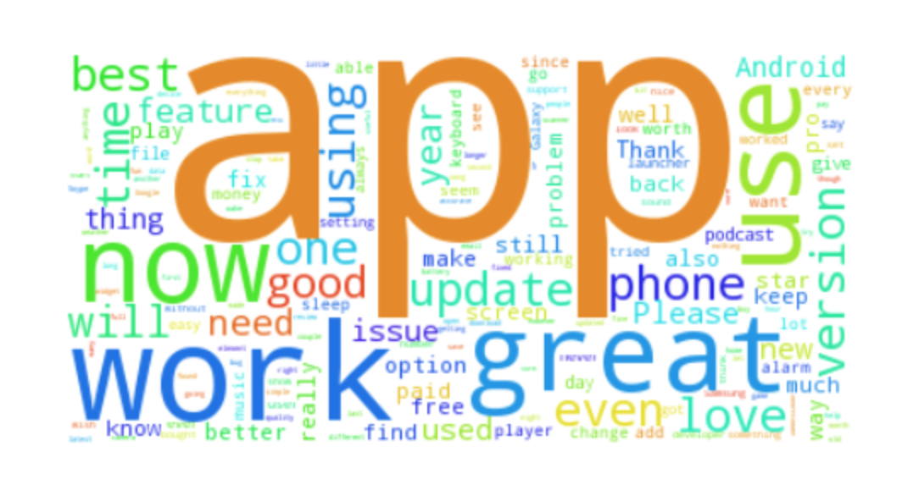
Top Paid in Android Apps

Slide 12
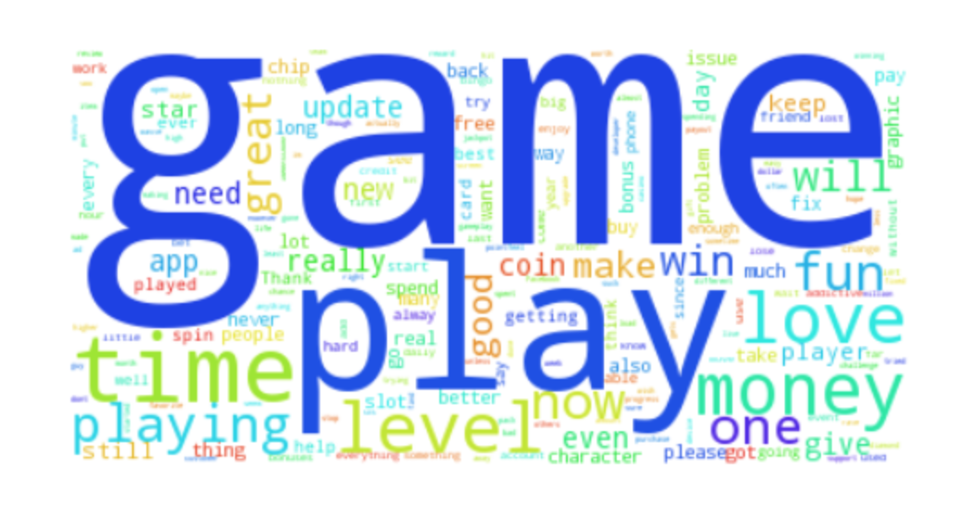
Top Grossing Games

Slide 13
Part II: Recommendation System
Several NLP Choices:
term frequency–inverse document frequency(TF-IDF)
LDA
LSI
What I use:
Doc2vec: converts word documents into vectors, Free in Genism Library
Model: Train, Test & Use

Slide 14
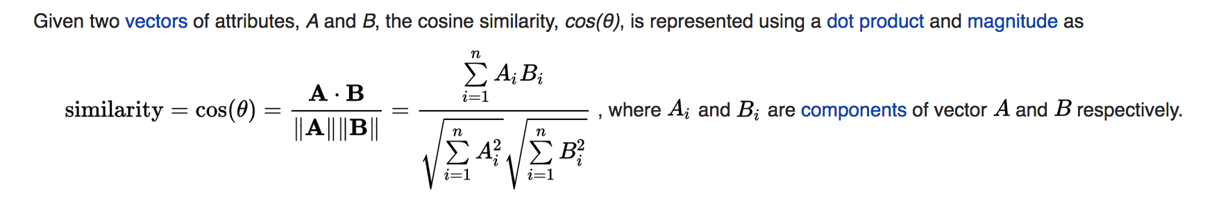
Cosine similarity
Similarity is the core of recommendation system. The model will find the most similar review based on the requirement a user gives.

Slide 15
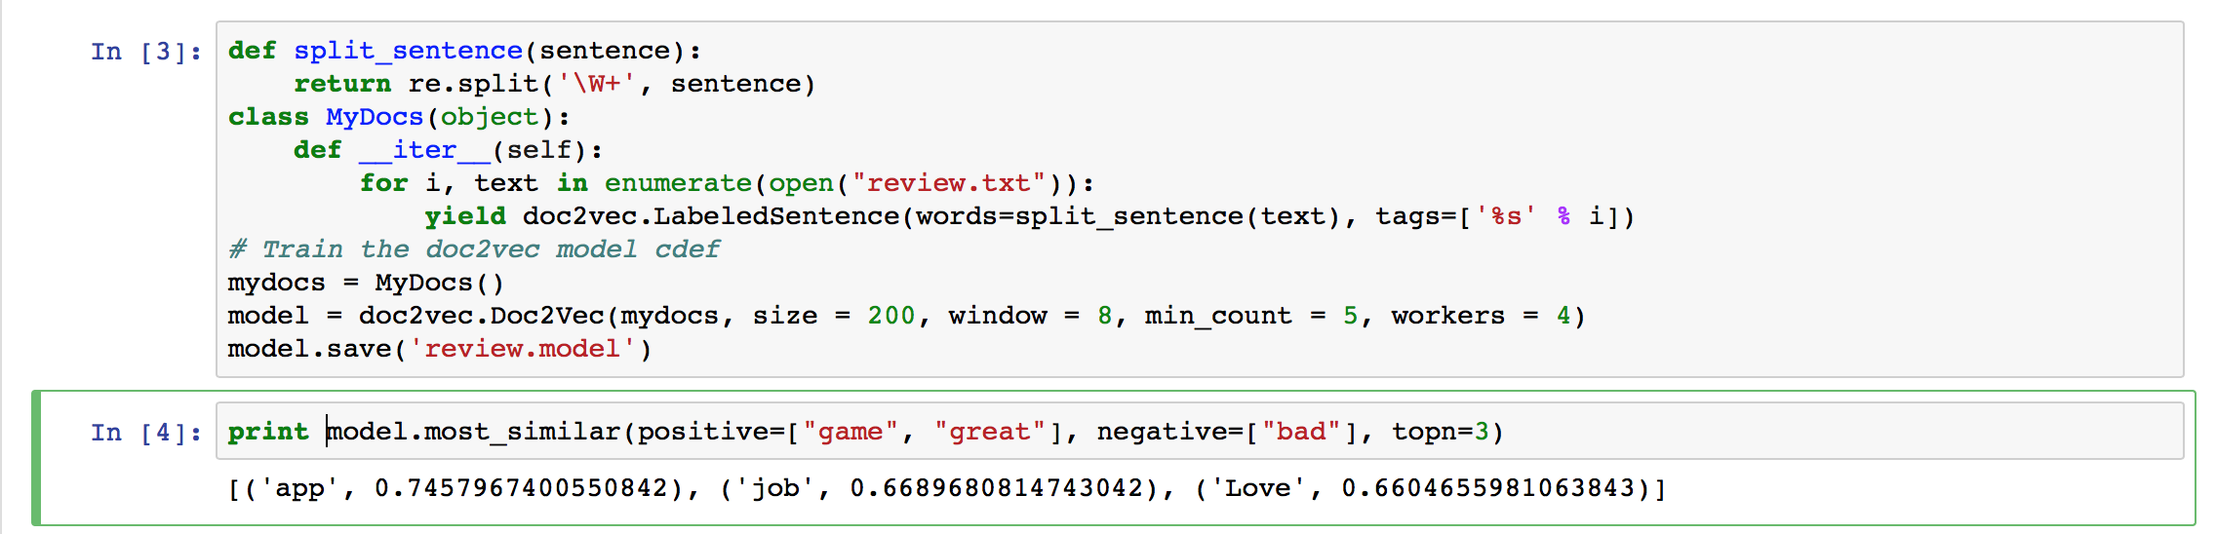
Using review.txt to train the model, then print an example
Print the top 3 words similar to “game”, “great”, different from “bad”
App, job, love

Slide 16
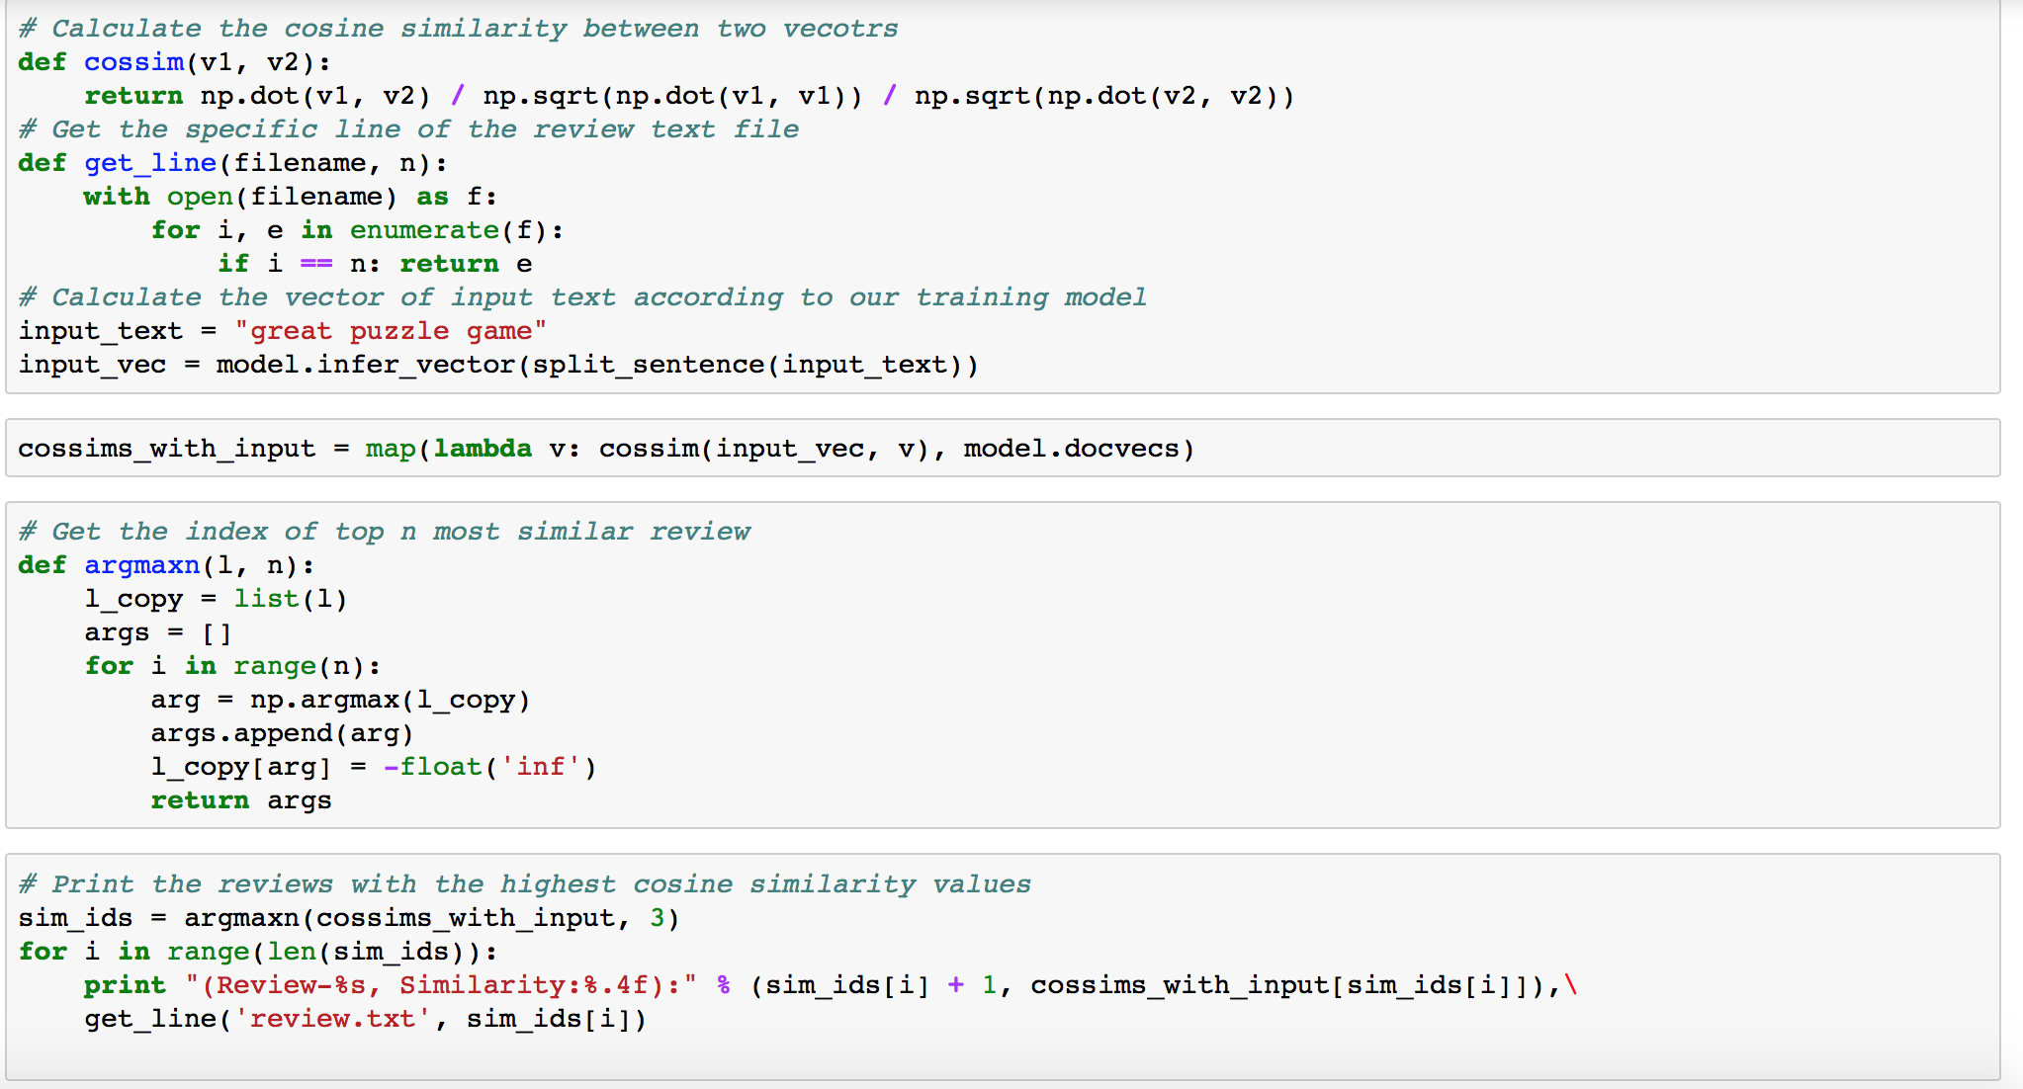
After defining Cosine Similarity Function, I write a input “great puzzle game”

Slide 17
Recommendation Result:
(Review-6784, Similarity:0.8765): The game is very fun, but the amount of little bugs in the game bothers me; tricks wont register or multiplier decides to not go up. I love the game but just wish it would run smooth, especially after its been out this long
App name is: Block! Hexa Puzzle , and the similarity is equal to: 0.7963,

Slide 18
New Input: “Great rpg Game”
Recommendation Result
(Review-5845, Similarity:0.9248): New version loses all stats. -- New version is low quality pixelated graphics. -- New version loses all paid purchases. -- New version is slow & laggy. -- No support, thieves. -- GARBAGE -- Advertisements in a paid application. Go rot in a pit. -- Seriously, you got paid, I don't care if it is $0.01 or $1000.00. -- You got paid, therefore advertisements should be removed. -- I'll take lessons taught here & keep them in mind to decide if I should purchase future titles from publisher & developers involved.
App name is: My Talking Angela , and the similarity is equal to: 0.7891,

Slide 19


My Talking Angela is a virtual pet app developed and released by Outfit7 in December 3, 2014. This game is fifteenth of the Talking Tom and Friends series and is similar to these one as My Talking Tom.

Slide 20
WHY?
1. Small DataSets
8972 reviews may not be enough to get a complete model. If dataset size increases to 1000000, we may find some reviews with higher similarity.
2. Spam Review
Assumption we use for recommendation system: most of the review are real and effective.
Spam Review: Trash reviews, Fake Reviews
3. Algorithm Shortcomings

Slide 21
Part III: Spam Review Analysis
According to Bing Liu’s Book, “Sentiment Analysis”, spam reviews can be separated into 2 big groups.
Trash review: a real review from a real customer. But due to some reasons, the information of this review is limited, wrong or misleading.
Fake Review: someone made it due to profit or other purposes.
Source: https://www.cs.uic.edu/~liub/FBS/fake-reviews.html

Slide 22
Duplicates---key feature to separate fake review
Type 1: Duplicates from different users on the same apps
Type 2: Duplicates from the same user on different apps
Type 3: Duplicates from the same user on the same apps
Type 4: Duplicates from different users on different apps

Slide 23
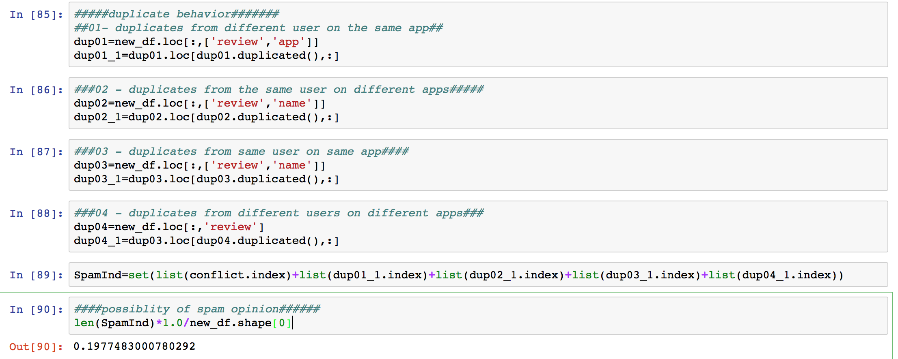
The percentage of duplicate is 19.77%

Slide 24
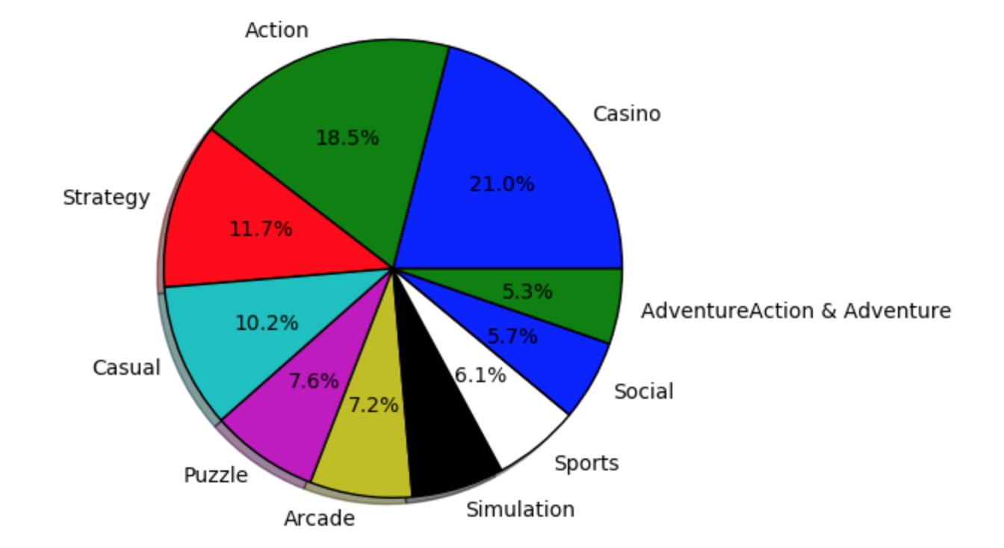
Distribution Of Duplicates

Slide 25
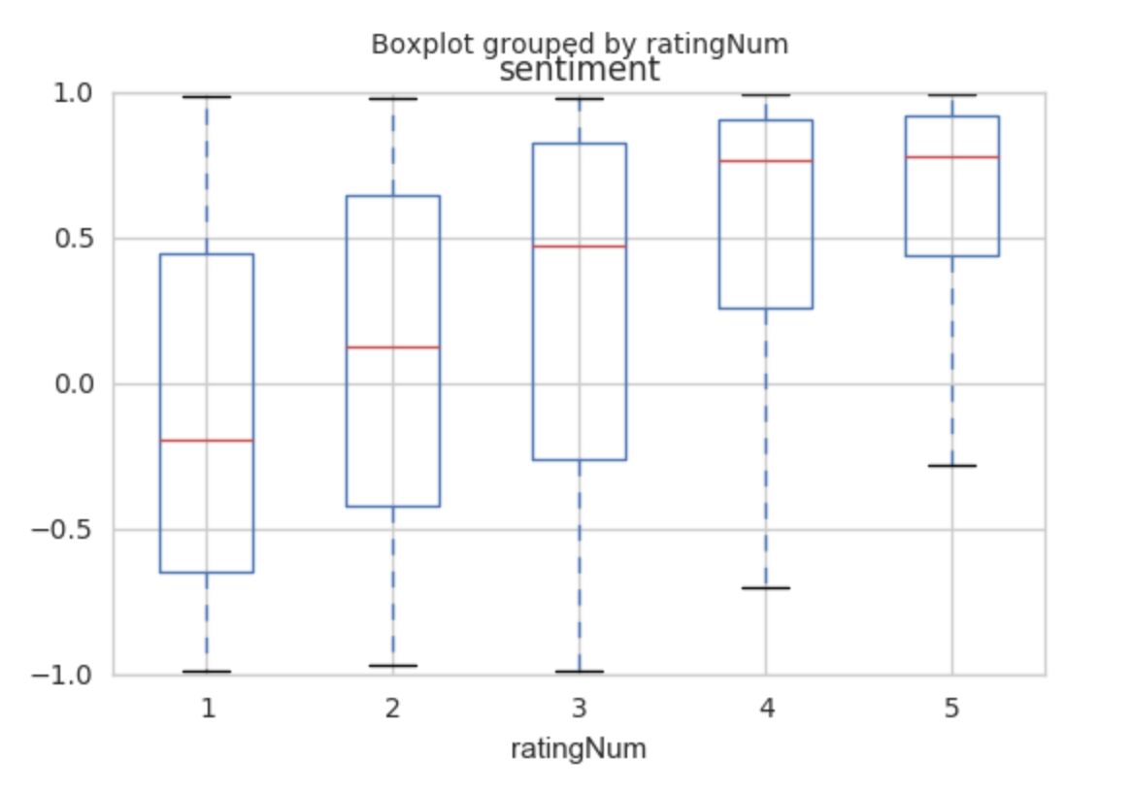
Trash Reviews
Start:
Sentiment V.S. Rating
Seems not a significant relationship

Slide 26
Relationship: logistic regression
Rating > 3: Positive
Rating <=3: Negative
Factors on this regression:
1. Length of reviews; 2. date index; 3. Number mentioned brand/company name; 4. Compound Sentiment; 5. Negative Sentiment; 6. Neutral Sentiment; 7. Positive Sentiment
Result:
Accuracy On Training Set: 69.9%
Accuracy On Test Set: 41.8%

Slide 27
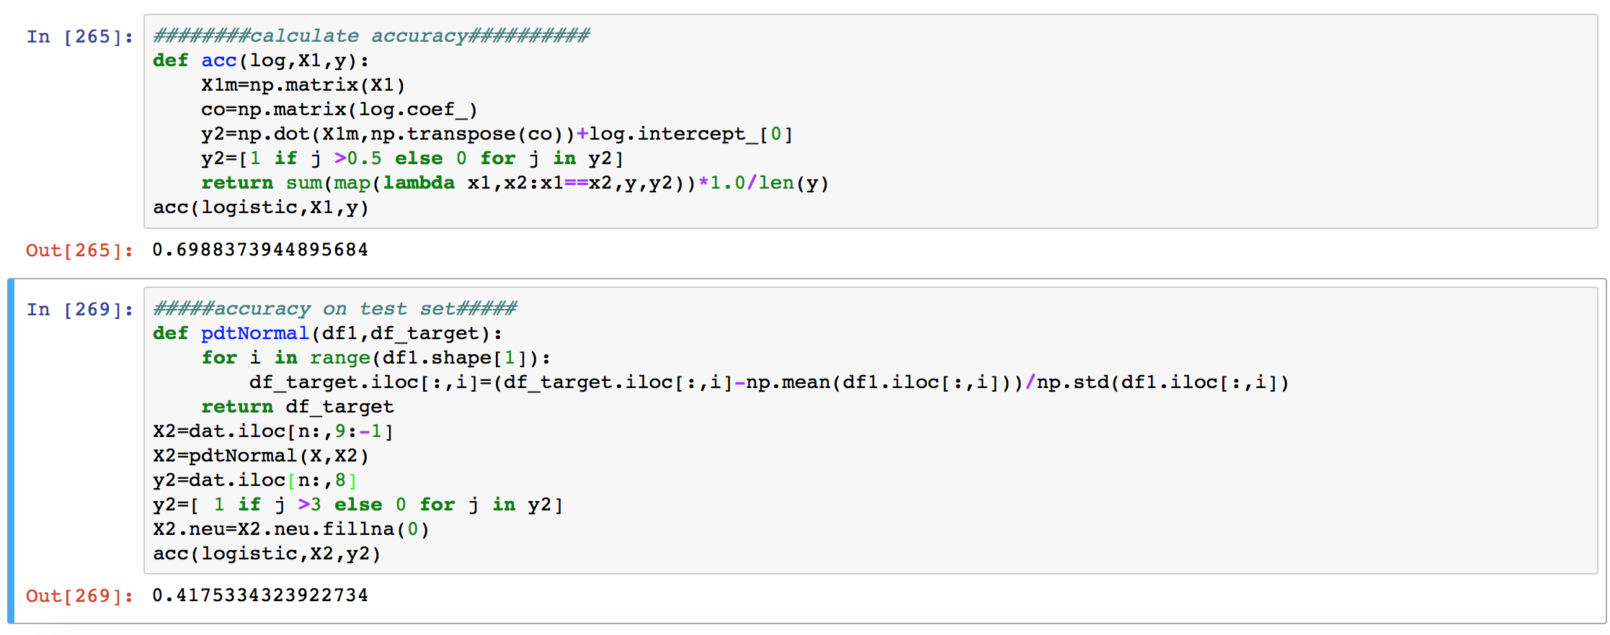
The Relationship between rating and review is not obvious.

Slide 28
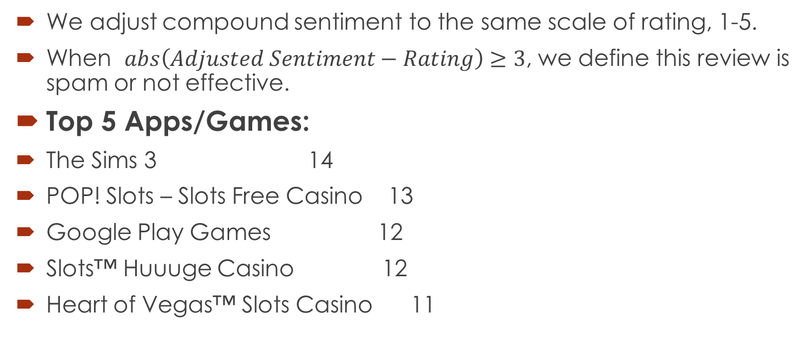
Define spam/trash review
We adjust compound sentiment to the same scale of rating, 1-5.
When $abs\left(Adjusted Sentiment−Rating\right)≥3$, we define this review is spam or not effective.
Top 5 Apps/Games:
The Sims 3 14
POP! Slots – Slots Free Casino 13
Google Play Games 12
Slots™ Huuuge Casino 12
Heart of Vegas™ Slots Casino 11

Slide 29
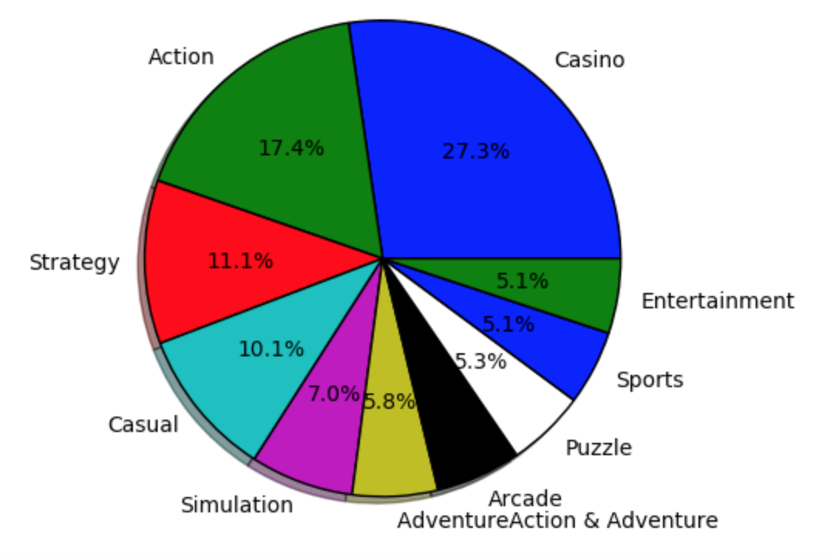
Spam Review Categories

Slide 30
Summary
1. For all the top apps people downloaded, “game” is the top 1 word.
2. doc2vec: a very cool algorithm to make text document to vector, then we can use cosine similarity or other distance to find the same or opposite sentences.
3. Spam Reviews manually detections: Trash / Duplicates
4. Don’t trust Casino apps’ reviews!!

Slide 31
What’s More?
1. Bigger Data sets
2. Using Cosine Similarity to find duplicates??
3. User-Interface Recommendation System
4. Spam Review Classifier( based on big datasets-->back to 1.)

Slide 32
Thanks!!!
References:
Sentiment Analysis and Opinion Mining,draft, Bing Liu, Morgan & Claypool Publishers, May 2012
https://www.cs.uic.edu/~liub/FBS/SentimentAnalysis-and-OpinionMining.pdf
30 Ways You Can Spot Fake Online Reviews, By Ben Popken April 14, 2010
https://consumerist.com/2010/04/14/how-you-spot-fake-online-reviews/
Thanks for Zeyu, Yaxiong and other people who help me!

